Slide 1
CHAPTER Preferences
3 and Utility

Slide 2
Axioms of Rational Choice
Completeness
  If A and B are any two situations, an individual can always specify exactly one of these possibilities:
    A is preferred to B
    B is preferred to A
    A and B are equally attractive

Slide 3
Axioms of Rational Choice
Transitivity
  If A is preferred to B, and B is preferred to C, then A is preferred to C
  Assumes that the individual’s choices are internally consistent
Continuity
  If A is preferred to B, then situations suitably “close to” A must also be preferred to B
  Used to analyze individuals’ responses to relatively small changes in income and prices

Slide 4
Utility
Assuming: completeness, transitivity, and continuity
  People are able to rank all possible situations from the least desirable to the most
Economists call this ranking utility
  If A is preferred to B
  Then the utility assigned to A exceeds or equal to the utility assigned to B: U(A) > =U(B)

Slide 5
Utility
Utility
  Individuals’ preferences are assumed to be represented by a utility function of the form U(x₁, x₂, . . . , x_{n})
    Where x₁, x₂,…, x_{n} are the quantities of each of n goods that might be consumed in a period
    This function is unique only up to an order-preserving transformation

Slide 6
Utility
Utility rankings are ordinal in nature
  Record the relative desirability of commodity bundles
  It makes no sense to consider how much more utility is gained from A than from B
  Impossible to compare utilities between people

Slide 7
Utility
Utility is affected by
  The consumption of physical commodities
  Psychological attitudes
  Peer group pressures
  Personal experiences
  The general cultural environment

Slide 8
Utility
The ceteris paribus assumption
  “Other things being equal”
  Devote attention exclusively to choices among quantifiable options
    While holding constant the other things that affect behavior

Slide 9
Utility
Utility from consumption of goods
  Assume - an individual must choose among consumption goods x₁, x₂,…, x_{n}
  Show his rankings using a utility function of the form: utility = U(x₁, x₂,…, x_{n}; other things)
  Often “other things” are held constant, so utility = U(x₁, x₂,…, x_{n})
  For two goods, x and y: utility = U(x,y)

Slide 10
Utility
Arguments of utility functions
    U(W) = utility an individual receives from real wealth (W)
    U(c,h) = utility from consumption (c) and leisure (h)
    U(c₁,c₂) = utility from consumption in two different periods
Two-good utility function U(x,y)
    More of any particular x_{i} during some period is preferred to less

Slide 11
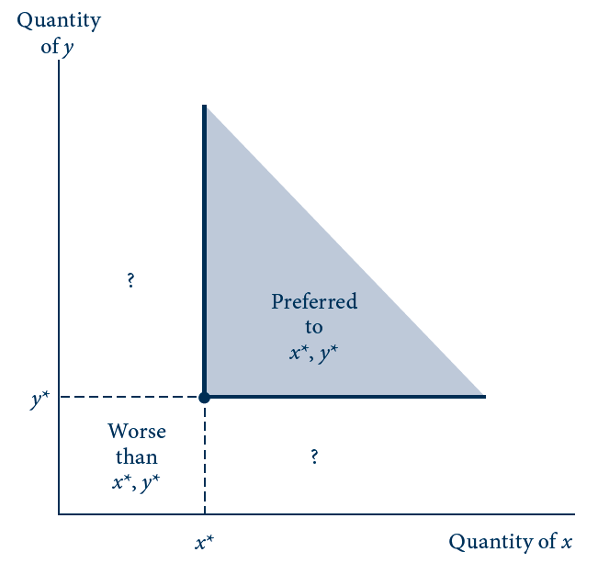
3.1 More of a Good Is Preferred to Less
The shaded area represents those combinations of x and y that are unambiguously preferred to the combination x*, y*. Ceteris paribus, individuals prefer more of any good rather than less.
Combinations identified by ‘‘?’’ involve ambiguous changes in welfare because they contain more of one good and less of the other.

Slide 12
Trades and Substitution
Indifference curve
  Shows a set of consumption bundles about which the individual is indifferent
  All consumption bundles that the individual ranks equally
  The bundles all provide the same level of utility

Slide 13
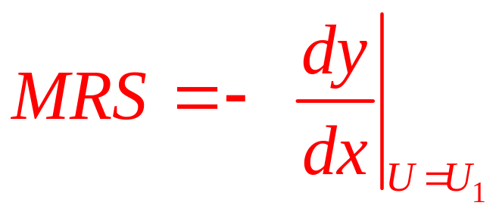
Trades and Substitution
Marginal rate of substitution, MRS
  The negative of the slope of an indifference curve (U₁) at some point
    Marginal rate of substitution at that point
  MRS changes as x and y change
    Reflects the individual’s willingness to trade x for y

Slide 14
3.2 A Single Indifference Curve
Quantity of y
y₁
y₂
U₁
Quantity of x
x₁
x₂
The curve U₁ represents those combinations of x and y from which the individual derives the same utility. The slope of this curve represents the rate at which the individual is willing to trade x for y while remaining equally well off. This slope (or, more properly, the negative of the slope) is termed the marginal rate of substitution. In the figure, the indifference curve is drawn on the assumption of a diminishing marginal rate of substitution.

Slide 15
Trades and Substitution
Indifference curve map
  Several indifference curves
  Level of utility represented by these curves increases as we move in a northeast direction
    More of a good is preferred to less

Slide 16
3.3 There Are Infinitely Many Indifference
Curves in the x–y Plane
Quantity of y
U₁ < U₂ < U₃
Increasing utility
U₃
U₂
U₁
Quantity of x
There is an indifference curve passing through each point in the x–y plane. Each of these curves records combinations of x and y from which the individual receives a certain level of satisfaction.
Movements in a northeast direction represent movements to higher levels of satisfaction.

Slide 17
Trades and Substitution
Indifference curves and transitivity
  Indifference curves cannot intersect
A set of points is convex
  If any two points can be joined by a straight line that is contained completely within the set
Convexity of indifference curves
  Diminishing MRS
  all combinations of x and y that are preferred or indifferent to a particular combination x∗, y∗ form a convex set

Slide 18
3.4 Intersecting Indifference Curves Imply Inconsistent Preferences
Quantity of y
C
D
E
A
U₁
B
U₂
Quantity of x
Combinations A and D lie on the same indifference curve and therefore are equally desirable. But the axiom of transitivity can be used to show that A is preferred to D. Hence intersecting indifference curves are not consistent with rational preferences. That is, point E cannot represent two different levels of utility.

Slide 19
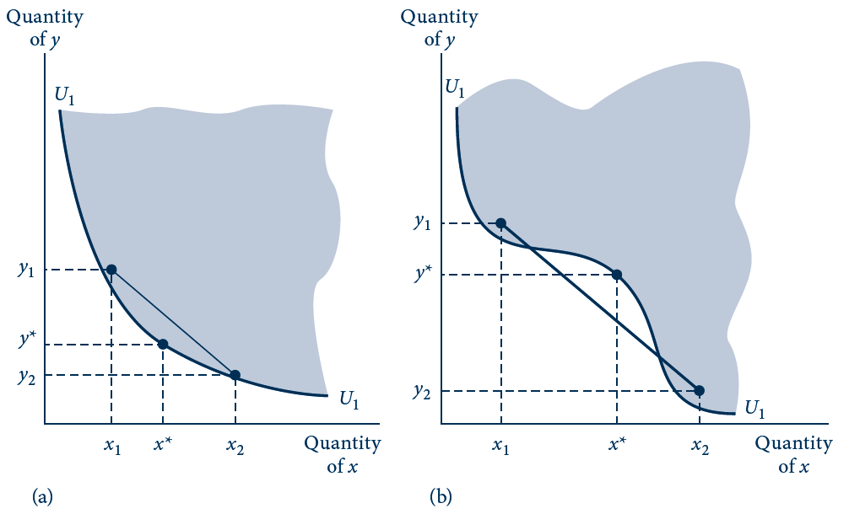
3.5 The Notion of Convexity as an Alternative
Definition of a Diminishing MRS
In (a) the indifference curve is convex (any line joining two points above U₁ is also above U₁). In (b) this is not the case, and the curve shown here does not everywhere have a diminishing MRS.

Slide 20
Trades and Substitution
Convexity and balance in consumption
  Individuals prefer some balance in their consumption
  ‘‘Well-balanced’’ bundles of commodities are preferred to bundles that are heavily weighted toward one commodity

Slide 21
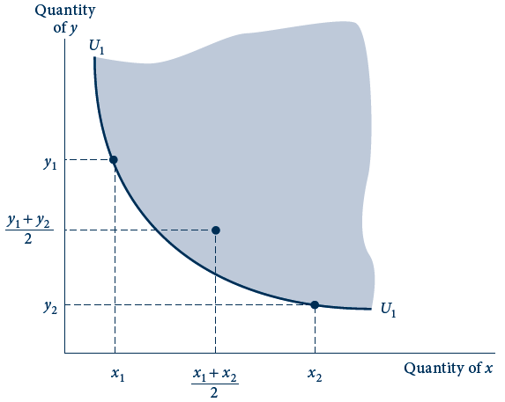
3.6 Balanced Bundles of Goods Are Preferred to
Extreme Bundles
If indifference curves are convex (if they obey the assumption of a diminishing MRS), then the line joining any two points that are indifferent will contain points preferred to either of the initial combinations. Intuitively, balanced bundles are preferred to unbalanced ones.

Slide 22
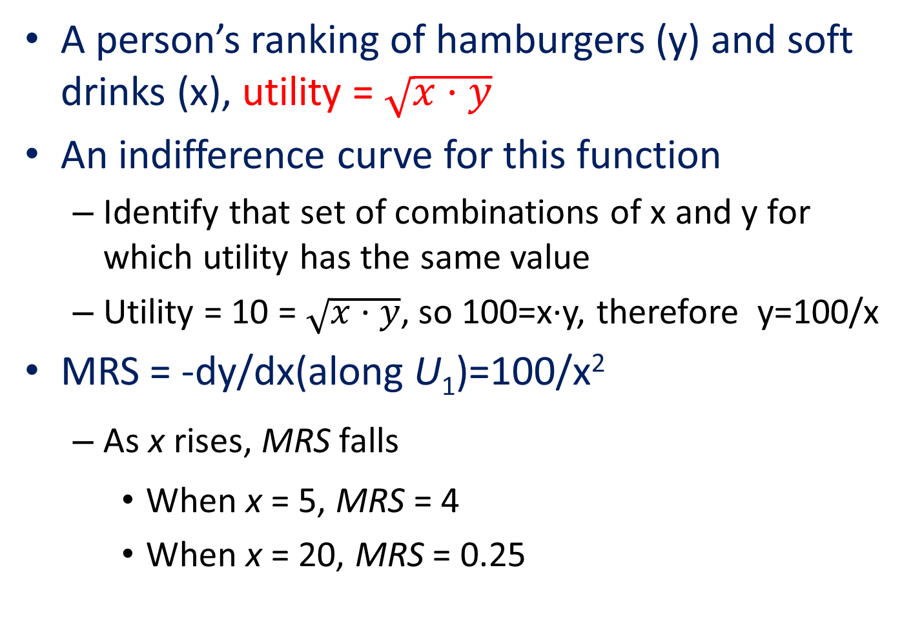
3.1 Utility and the MRS
A person’s ranking of hamburgers (y) and soft drinks (x), utility = $\sqrt{x·y}$
An indifference curve for this function
  Identify that set of combinations of x and y for which utility has the same value
  Utility = 10 = $\sqrt{x·y}$, so 100=x·y, therefore y=100/x
MRS = -dy/dx(along U₁)=100/x²
  As x rises, MRS falls
    When x = 5, MRS = 4
    When x = 20, MRS = 0.25

Slide 23
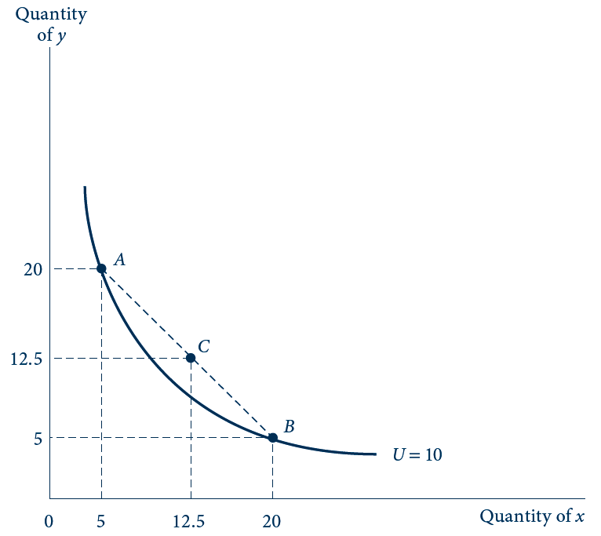

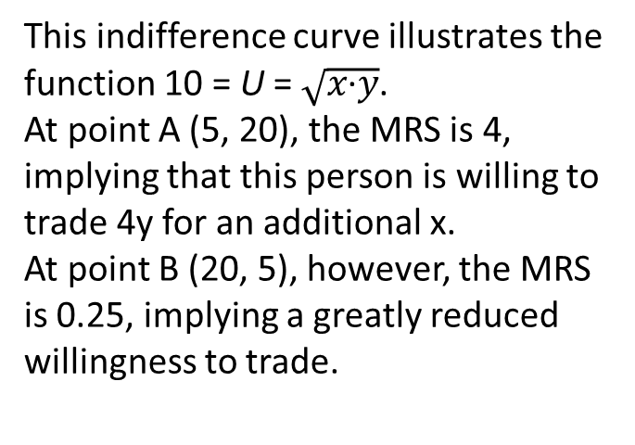
3.7 Indifference Curve for Utility=$\sqrt{\text{x}\text{·}\text{y}}$
This indifference curve illustrates the function 10 = U = $\sqrt{\text{x}\text{·}\text{y}}$.
At point A (5, 20), the MRS is 4, implying that this person is willing to trade 4y for an additional x.
At point B (20, 5), however, the MRS is 0.25, implying a greatly reduced willingness to trade.

Slide 24
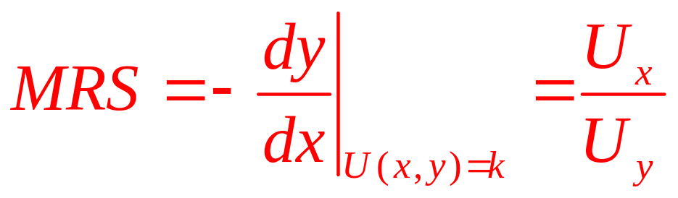
The Mathematics of Indifference Curves
An individual – consumes x and y
  Utility = U(x,y)
  Specific level of utility, k: U(x,y)=k
  Trade-offs: the rate at which x can be traded for y
    Is given by the negative of the ratio of the ‘‘marginal utility’’ of good x to that of good y

Slide 25
The Mathematics of Indifference Curves
Diminishing MRS
  Requires that the utility function be quasi-concave
  This is independent of how utility is measured
Diminishing marginal utility
  Depends on how utility is measured
Thus, these two concepts are different

Slide 26
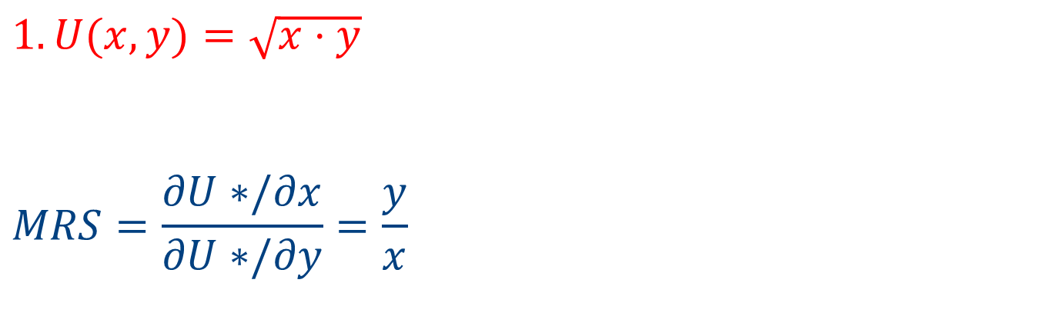
3.2 Showing Convexity of Indifference Curves
$$1. U(x,y)=\sqrt{x⋅y}$$
$$MRS=\frac{∂U∗/∂x}{∂U∗/∂y}=\frac{y}{x}$$
MRS is diminishing as x increases and y decreases
Therefore, the indifference curves are convex

Slide 27
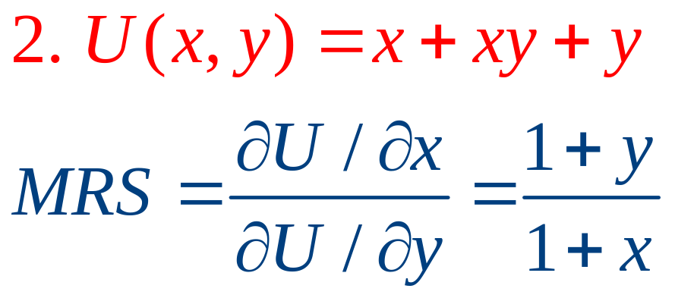
3.2 Showing Convexity of Indifference Curves
MRS is diminishing as x increases and y decreases
Therefore, the indifference curves are convex

Slide 28
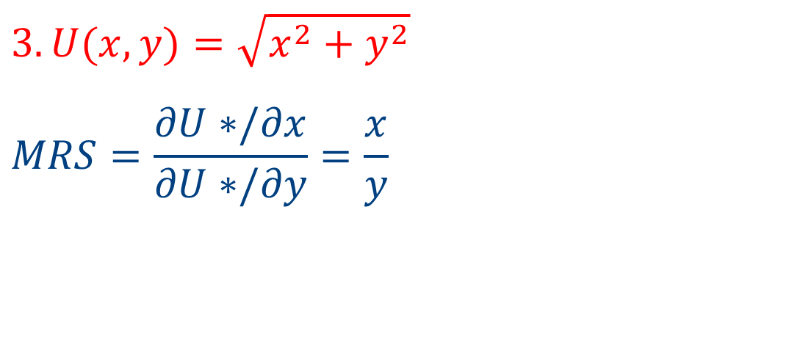
3.2 Showing Convexity of Indifference Curves
$$3. U(x,y)=\sqrt{x^{2}+y^{2}}$$
$$MRS=\frac{∂U∗/∂x}{∂U∗/∂y}=\frac{x}{y}$$
As x increases and y decreases, the MRS increases!
The indifference curves are concave, not convex
This is not a quasi-concave function

Slide 29
Utility Functions for Specific Preferences
Cobb-Douglas Utility, U(x,y) = x^{α}y^{β}
  α and β are positive constants, each <1
  The relative sizes of α and β indicate the relative importance of the goods
  Normalize so that α + β = 1
U(x,y) = x^{δ}y^{1-δ}
    Where δ=α/(α+β) and 1-δ=β/(α+β)

Slide 30
Utility Functions for Specific Preferences
Perfect substitutes
  Linear indifference curves
U(x,y) = αx + βy
  Where α and β are positive constants
  The MRS will be constant along the indifference curves
    MRS = α/β along the entire indifference curve

Slide 31
Utility Functions for Specific Preferences
Perfect complements
  L-shaped indifference curves
U(x,y) = min (αx, βy)
  Where α and β are positive parameters

Slide 32
Utility Functions for Specific Preferences
CES Utility (constant elasticity of substitution)
U(x,y) = [x^{δ} + y^{δ}]^{1/δ} , where δ ≤ 1, δ ≠ 0
  For δ = 1: U(x,y) corresponds to perfect substitutes case
  For δ approaching 0: U(x,y) approaches Cobb-Douglas
  For δ approaching -∞: U(x,y) approaches the case of perfect complements
  Monotonic transformation U* = U^{δ}/δ, so
  U(x,y) = x^{δ}/δ+ y^{δ}/δ

Slide 33
Utility Functions for Specific Preferences
The elasticity of substitution, σ
  CES utility ⇒ σ = 1/(1 - δ)
  Perfect substitutes ⇒ σ = ∞
  Perfect complements ⇒ σ = 0

Slide 34
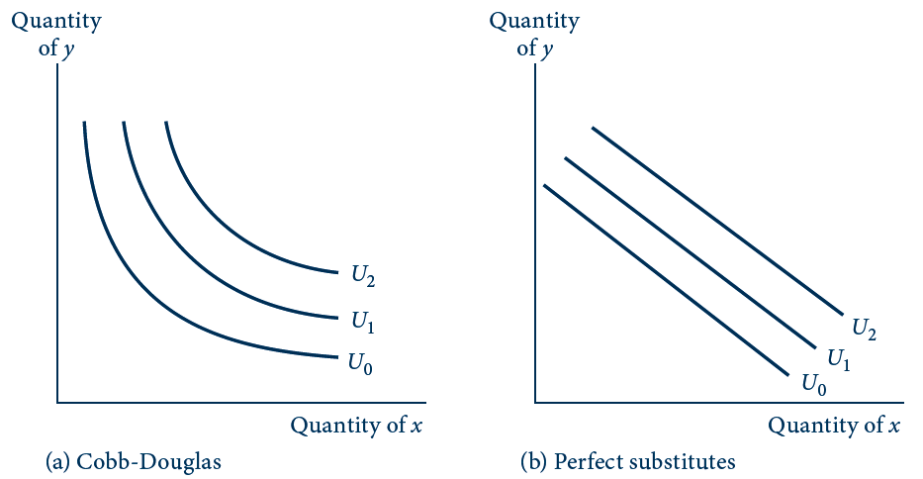
3.8 Examples of Utility Functions (a, b)
The four indifference curve maps illustrate alternative degrees of substitutability of x for y. The Cobb–Douglas and constant elasticity of substitution (CES) functions (drawn here for relatively low substitutability) fall between the extremes of perfect substitution (b) and no substitution (c).

Slide 35
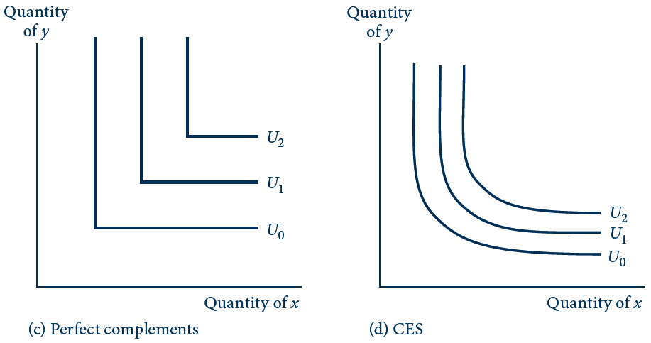
3.8 Examples of Utility Functions (c, d)
The four indifference curve maps illustrate alternative degrees of substitutability of x for y. The Cobb–Douglas and constant elasticity of substitution (CES) functions (drawn here for relatively low substitutability) fall between the extremes of perfect substitution (b) and no substitution (c).

Slide 36
3.3 Homothetic Preferences
Utility function is homothetic
  If the MRS depends only on the ratio of the amounts of the two goods
    Not on the total quantities of the good
Perfect substitutes
  MRS is the same at every point
Perfect complements
  MRS is ∞ if y/x > α/β
  MRS is undefined if y/x = α/β
  MRS is 0 if y/x < α/β

Slide 37
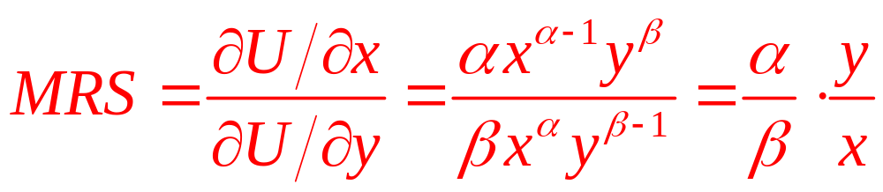
3.3 Homothetic Preferences
General Cobb-Douglas function
  The MRS depends only on the ratio y/x

Slide 38
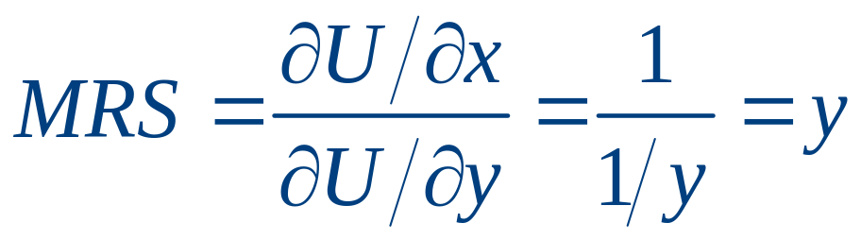
3.4 Nonhomothetic Preferences
Some utility functions do not exhibit homothetic preferences
utility = U(x,y) = x + ln y
  Good y exhibits diminishing marginal utility, but good x does not
  The MRS diminishes as the chosen quantity of y decreases, but it is independent of the quantity of x consumed

Slide 39
The Many-Good Case
Suppose utility is a function of n goods given by U(x₁, x₂,…, x_{n})
Equation U(x₁, x₂,…, x_{n})=k
  Defines an indifference surface in n dimensions
    All those combinations of the n goods that yield the same level of utility (Convex surface)
  Quasi-concave

Slide 40
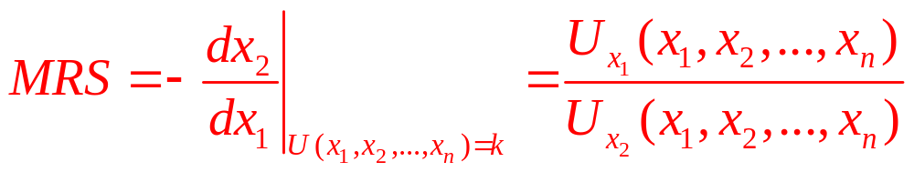
The Many-Good Case
MRS with many goods

Slide 41
Special Preferences
The utility function
  General concept
  Can be adapted to a large number of special circumstances
Aspects of preferences that economists have tried to model
    (1) threshold effects
    (2) quality
    (3) habits and addiction
    (4) second-party preferences

Slide 42
Threshold effects
People may be ‘‘set in their ways’’
  May require a rather large change in circumstances to change what they do
  Assume individuals make decisions as though they faced thresholds of preference
Bundle A might be chosen over B only when: U(A) > U(B) + ε
  Where ε is the threshold that must be overcome

Slide 43
Quality
Many consumption items differ in quality
  Focus on quality as a direct item of choice
Utility = U(q,Q)
  q is the quantity consumed
  Q is the quality of that consumption
Utility = U[q,a₁(q),a₂(q)]
  Good q provides a well-defined set of attributes of goods (a)
    Assumes that those attributes provide utility

Slide 44
Habits and addiction
Habits
  Are formed when individuals discover they enjoy using a commodity in one period
  And this increases their consumption in subsequent periods
Addiction
  An extreme case of habits
  Past consumption significantly increases the utility of present consumption

Slide 45
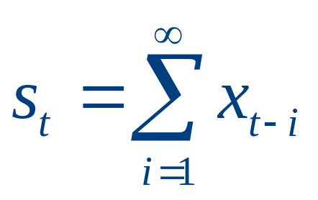
Habits and addiction
Utility = U(x_{t},y_{t},s_{t})
  Utility in period t depends on
    Consumption in period t and the total of all previous consumption
Utility = U(x_{t}*,y_{t})
  x_{t}* is a function of
    Current consumption (x_{t}) and consumption in the previous period (x_{t-1})

Slide 46
Second-party preferences
Second-party preferences
  Can be incorporated into the utility function of person i
Utility = U_{i}(x_{i},y_{i},U_{j})
  Where U_{j} is the utility of someone else
If ∂U_{i}/∂U_{j}>0
  This person will engage in altruistic behavior

Slide 47
Second-party preferences
If ∂U_{i}/∂U_{j}<0
  This person will demonstrate the malevolent behavior associated with envy
If ∂U_{i}/∂U_{j}=0
  The usual case
  Middle ground between these alternative preference types

